Slide 1


Slide 2
Sql wars
The attack of the clones and the rebellion of the containers

Slide 3

SQL WARS
@giulianolatini
giulianolatini
GIULIANO LATINI
giulianolatini

Slide 4


SQL WARS
@suxstellino
suxstellino
ALESSANDRO ALPI
suxstellino

Slide 5
For a long time we have been faced with…

Slide 6
Three tricky problems
Debug our apps against production data (also for edge cases)
Execute performance and integration tests against prod db
Review the deployment scripts in use to prevent regressions
Notes:
ALE:
Our customers used to send us the tickets for fixing bugs and solving problems. While this can be simple, it’s not the same for reproducing steps using mock or test data. One of the most popular tasks that a DBA must do for helping developers to fix a bug, is to make a script for exporting thousands of rows in non-production environments. Having real production data in non-production environments without writing a single line of code is mandatory for saving time and improve the quality of our debug.
With a, let’s say, copy of our production databases we can also execute integration tests and performance tests. We can understand better how our queries will run in production using the copied statistics, metadata as well as the real data cardinality.
Finally, we can execute a set of pre/post deploy scripts against our isolated copy of the production database in order to prevent regressions due to mistakes on those scripts. The scripts themselves, can be written manually or generated by a parser, like the Entity Framework migrations, but it’d be good to check that every single script will work BEFORE promoting them into production.

Slide 7
Everything led to…

Slide 8
…provision production data
You can get real, production data in a couple of minutes
Automating the process of data generation is easy
You end up using this data in a non-production environment
Notes:
ALE:
Let’s explain “a couple of minute”. This is true when a, let’s say, data-image has been created. How long it takes, using clones the same as backup + optional data masking time. Using containers, almost the same. Having these images, we can update and create isolated copies of them in max 30 sec – 2 mins. This allows us to automate both the data-image and clones/container creation. Data-images should be generated when the requirement is to sync with the latest data. Clones and containers could be created every 2/3 mins. This process can be done also manually, using command lines and a user-friendly web portal (for the SQL Clone solution) and allows us to get production data (optionally obfuscated) in a, let’s say test or stage environment.

Slide 9
With this requirements
Real, anonymised data (via obfuscation)
Isolated, repeatable tests
Short feedback cycle
Notes:
ALE:
Obfuscation can be done with a set of SQL Scripts or executables, but when using SQL Clone™ solution by RedGate® you can integrate in a “pre/post” data-masking step while creating clones, using DataMaskter™ by RedGate®. Whis will slow the creation of the data image, but it help us to hide sensitive data.
Each clone is completely isolated, as a new container is for a docker solution. This means that you can update the data on each database clone without affecting rows of the others. So you can test many times in a repeated and isolated way. Additionally, if you don’t write data, your database clones will store just 50MB each.
This quick approach lets the DBAs to save time and to get a feedback as soon as possible, many times in a short period of time.

Slide 10
Approaches

Slide 11
Classic approaches
Restore production databases
Bulk Load via ETLs or SQL scripts
Copy between servers via SQL scripts
Notes:
ALE:
Usually DBAs must replicate data between production and non-production environments. How they do this boring and repeated task? Just copying data or investing time for creating and maintaining their scripts for copying and obfuscating data. Databases with no changes in structures can be managed this way. But now, think about a database (or a set of) which changes twice or more per week or even day! A new field, a dropped column, a data-type change could break those scripts.
Another problem is that our scripts are error prone, and they’re not so simple to debug. Also if we use tools like ETLs, which are not so good when we’re working in team (SSIS are XMLs that change for each version of the development tool).
Finally, we need to override some security best practices when accessing cross servers or just to copy data from production servers to test environments. And do not forget how much bandwidth we will use for migrating large amount of data!

Slide 12
Modern approaches
Native clones (DBCC CLONEDATABASE)
Virtual clones (SQL Clone by RedGate)
Containers (Docker)
Notes:
ALE:
Native clones are generated by the Database Console Command CLONEDATABASE. The command creates a clone of a database with no records, except for the statistics and the metadata. This is useful just for performance analysis. We will not speak about it hereafter. I’ve mentioned it just to let you know something exists for perf analysis.
Virtual clones, provided by SQL Clone by RedGate®, are copies of databases with no exceptions. They are generated from a data-image, which is a full-byte copy of the database. Starting from that image, you can create all the clones you need. The data is stored in the data-image, and each clone act as an isolated snapshot of that source. When writing new records, they’re added in the clones. This means that each clone is like a fork of the data-image with the “delta” records inserted/edited. Each clone needs just 50MB on the disk.
GIULIANO:
The isolation provided by the containers allows us to execute the tests against a SQL-Engine which reads data through the volume. The volume itself contains the production data and «protect» the real data to be modified.

Slide 13
SQL Clone – behind the hood
Source: Data-Image
Full-byte copy of the source database
From backup/live database
Isolated object: Clone
Isolated copy of the database
Created in less than 30sec
Each data-image can generate many clones

Slide 14
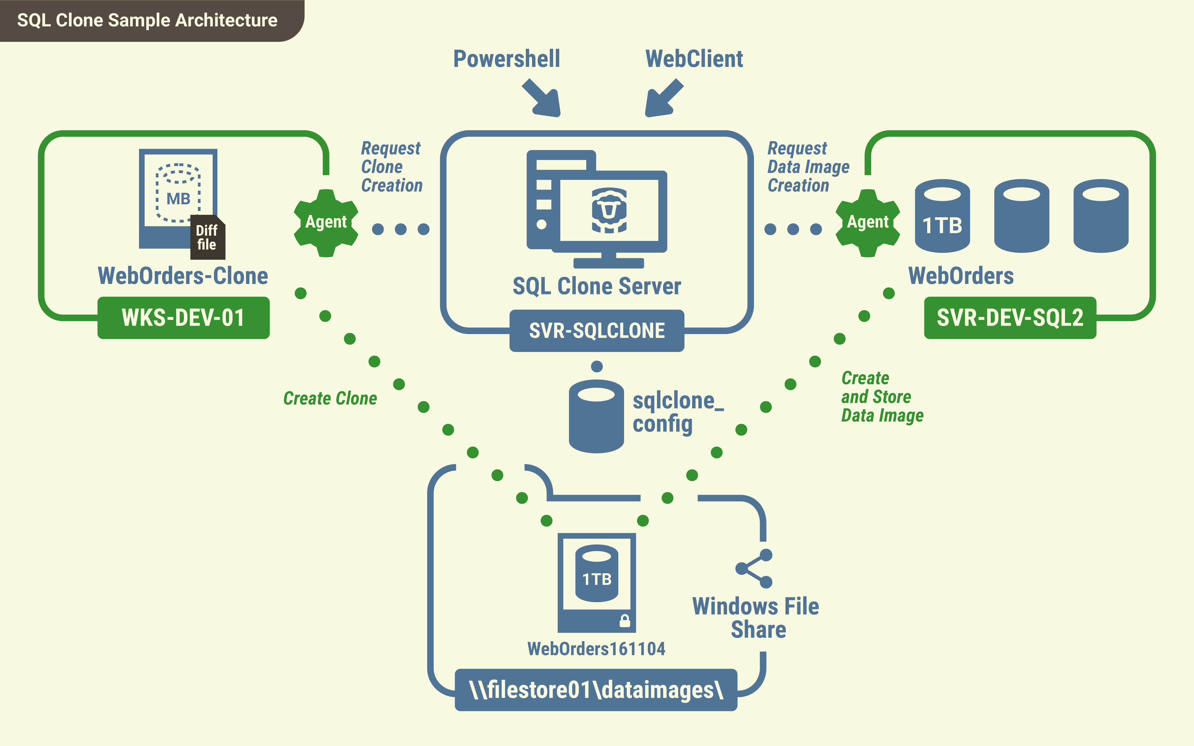
SQL Clone – architecture
Notes:
ALE:
Describe with pointers.

Slide 15

Sql wars
DEMO – SQL Clone

Slide 16
Containers
Run SQL engine with less footprint
running on multiOS environment
high and quickly consolidation
Infrastructure as Code
on-premise or in the cloud – no difference
Isolated object to access data
COW fs features have zero costs to resolve write collision
multiple engine access same data
writing and pesistences isolation
Notes:
GIULIANO: With a container-based solution, the SQL-Engine footprint is 10% of the windows server desktop scenario. Upgrading it is easier if you isolate data using Docker Volumes. SQL containers allow us to deploy and manage with an "Infrastructure-as-code" approach. IaC helps to automate the SQL Server Instances' management as well as monitoring them. The isolated data container and the COW filesystem features give the advantage to use the same data file by multiple engines. The read request operations made by multiple sources for the same data in COW is action with no costs. Speaking about writes, the COW fs manages them as single write into the source. Write layer is joined 1 to 1 to the source. COW creates a layer at the first write request from the source and then join it with the source. COW sorts them by creation time into a stack. The source knows the write and the read-only layers created before. In case of any conflict on a file, the top in the stack "wins" and the bottom one's "lose". The source uses the nearest file on the layers stack. Inside the data volume the COW feature are disable, because sql engine have down of performance. Outside the docker volume, in a COW filesystem We can make a hot snapshot of data volume making a copy where connect a other sql engine.

Slide 17
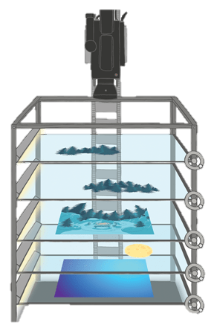
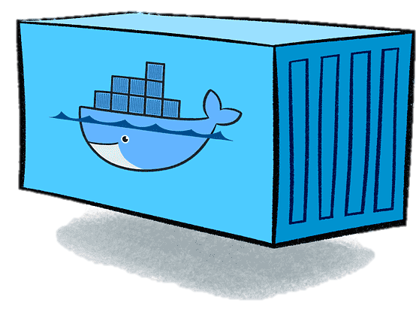

Containers
TIME
SQLPROD
SQLTEST
SQLTEST
Notes:
GIULIANO: Like for Disney's Multiplane Camera, zooming gets the illusion of depth for the observer. When switching the container in the stack of layers mentioned before, the "observer" makes a step. As in the slide, the test environments can read the data in the production environment, but not vice versa. This happened when we make snapshot, a “photo” of production in different times. The Production is the nearest layer to camera, other layers are snapshot.

Slide 18
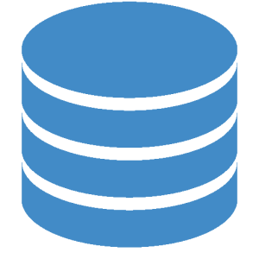
Docker solution
SQL TESTSUITE1
docker run -d \
-v dbtest:/data sql
SQL PRODUCTION
docker run -d \
–v dbprod:/data sql
buttervolume clone dbprod dbtest
Notes:
GIULIANO: here is the proposed solution: we have a SQL-Engine with rows of data in the production environment and another one for running the test suite against the production data mentioned before. The DB volume is located where the data rows are physically stored. If We want update the data used into testsuite We destroy old dbtest and make a new clone. The dbtest volume is a hot snapshot of production data in dbprod. Both the SQL-Engines have the databases linked the data directory with the same configuration and users. The test suite will run against the production's data. When the tests will write into the tables, the COW feature helps to make it without modifying production data (transparency).

Slide 19
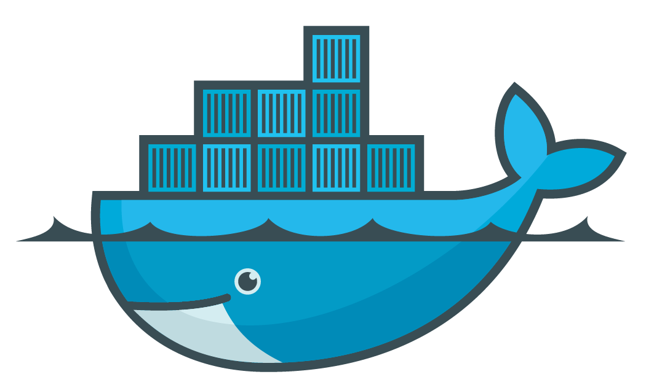
Sql wars
DEMO – SQL Server with Containers

Slide 20
SQL Clones vs Containers
Containers
Quick, isolation
Cross platform
Production must be already «containerised»
Sql Clone
Quick, isolated
Windows-only
Perfect for classic VMs (no container support)

Slide 21
Both will resolve tricky issues

Slide 22
@giulianolatini
giulianolatini
giulianolatini

Slide 23
Resources
DBCC CLONEDATABASE: https://docs.microsoft.com/en-us/sql/t-sql/database-console-commands/dbcc-clonedatabase-transact-sql?view=sql-server-ver15
SQL Clone: https://www.red-gate.com/products/dba/sql-clone/
Docker for SQL Server: https://docs.microsoft.com/en-us/sql/linux/quickstart-install-connect-docker?view=sql-server-ver15&pivots=cs1-bash
Docker Hub: https://hub.docker.com/_/microsoft-mssql-server
Microsoft Container Registry: https://azure.microsoft.com/en-us/services/container-registry/

Slide 24
Resources
buttervolume: https://github.com/anybox/buttervolume
Volume Shadow Copy: https://msdn.microsoft.com/en-us/library/windows/desktop/bb968832(v=vs.85).aspx
Differencing Virtual Hard disk: https://technet.microsoft.com/en-us/library/cc720381(v=ws.10).aspx
StackOverflow database: https://www.brentozar.com/archive/2015/10/how-to-download-the-stack-overflow-database-via-bittorrent/
SQL Clone on AzureDevOps: https://www.youtube.com/watch?v=fVbmUZ6FhEc

